Slide 1
AI Meme Generator
Context-Aware Meme Recommendation Using Text Analysis
By: Sonal Kamble

Slide 2
Introduction
What is this project?
A Java-based app that generates a relevant meme or GIF based on a sentence typed by the user.
Why does this matter?
Memes are a universal communication tool.
Automating meme selection saves time and adds humor to everyday communication.
Meme recommendation is an emerging topic in AI (context + emotion detection).

Slide 3
Motivation
Why did I choose this project?
I wanted an AI project that is simple but fun and creative.
Text-to-meme is an unexplored area with lots of potential.
It allowed me to work with context understanding, keyword mapping, and multimedia.

Slide 4
Architecture Overview
UI Layer
(Swing)
Logic Layer
(Keyword Scoring)
Data Layer
(Maps of Memes)

Slide 5
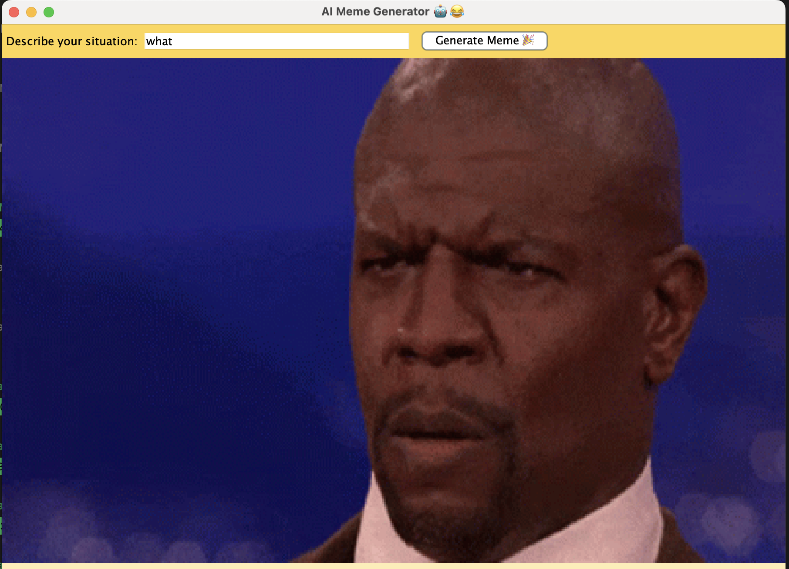
System Overview
Input: user’s text
Processing: keyword extraction, context detection
Output: a meme or GIF displayed fullscreen
A simple pipeline diagram:
→ → → →
User Input
Keyword Matching
Scoring Engine
Best Meme

Slide 6
Dataset & Design
A weighted map of memes (Map<String, Meme>)
Each meme includes: caption, GIF URL, keyword weight map
Memes from: The Office, Modern Family, Breaking Bad, Big Bang Theory, and Bollywood
Dataset currently ~20 memes, expandable to 100+

Slide 7
Keyword Matching Algorithm
Extract keywords from user text
Compare with meme keyword maps
Compute score
Choose highest-scoring meme

Slide 8
GIF Integration
Full-screen GIF scaling
Support for online GIF URLs
Smooth rendering in Swing

Slide 9
Experimental Results
“I’m stressed about my deadline.” → Michael Scott: NO GOD PLEASE NO!
“My experiment finally worked!” → Jesse Pinkman: Yeah Science!
“I’m feeling sarcastic.” → Cameron Tucker sarcastic GIF
“I feel powerful.” → Walter White: I am the one who knocks.”

Slide 10
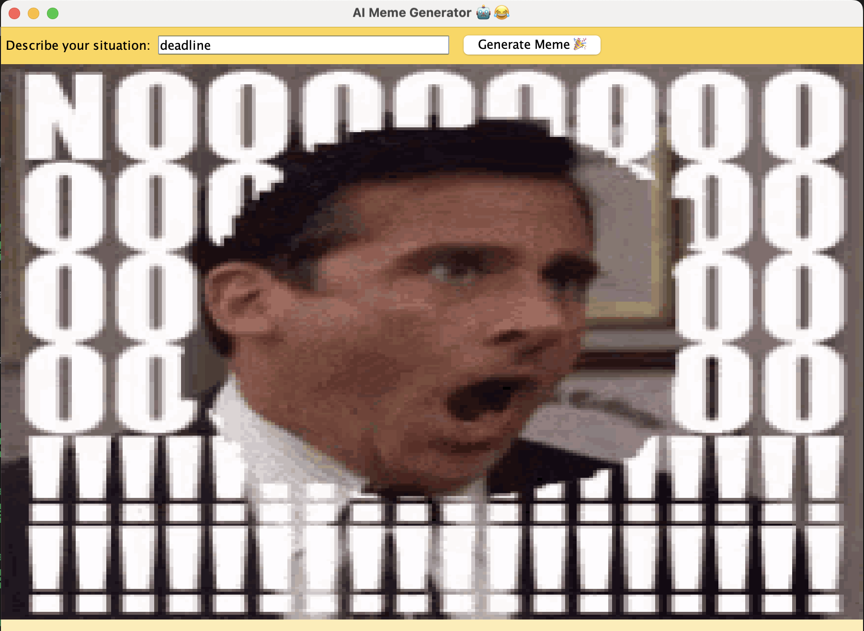
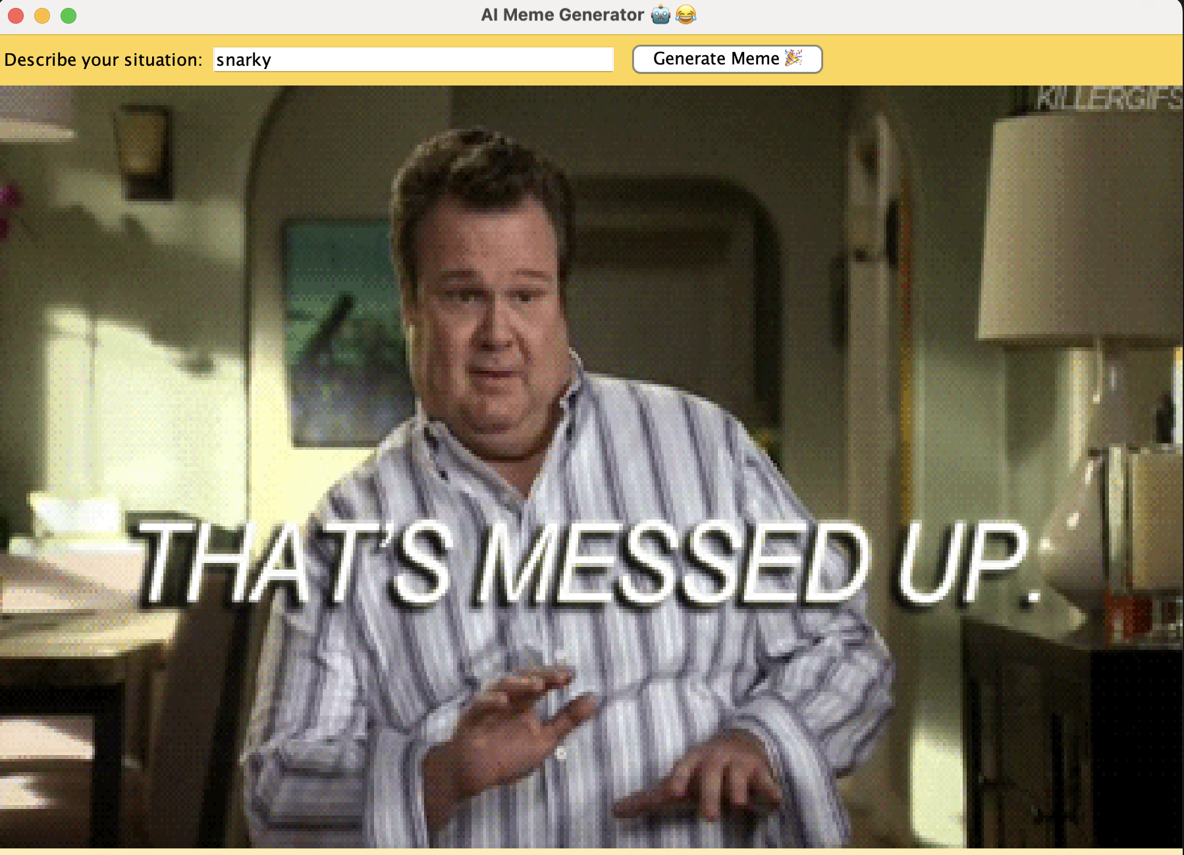
Output Examples

Slide 11
Work Completed
Built dataset with keyword weighting
Created Swing UI
Implemented full GIF support
Added meme repository
Implemented keyword scoring
Made the UI colorful & engaging

Slide 12
Work Remaining
Grammar-based parsing to detect subject/object
Larger dataset
User testing
Possibly integrate NLP libraries later

Slide 13
Challenges
Keyword overlap causing wrong meme matches
GIF sizing issues in Swing
Defining evaluation criteria

Slide 14
Conclusion
Built a working, context-aware meme generator
Simple, scalable, and fun AI project
Shows practical use of keyword scoring
Strong foundation for future AI improvements

